Slide 1
Blinkit Sales Analysis
Data-Driven Insights for Sales & Customer Experience Optimization
By Gaurav Layak

Slide 2
📊 Project Requirements
OBJECTIVE:
To conduct a comprehensive analysis of Blinkit's sales performance, customer satisfaction, and inventory distribution to identify key insights and opportunities for optimization using various KPIs and visualizations in Power BI.
Relevant KPI’s :
Total Sales
Average Sales
No. of Items
Average Ratings
Total Sales by fat Content
Sales by Items type
Total Sales by different Years
Sales by Outlet Size
All Metrics of Outlet Types etc.

Slide 3
📈 Data Analysis Process
1. Data Cleaning & Preprocessing
Standardized fat content categories (e.g., ‘LF’ → ‘Low Fat’).
Handled missing values in rating and sales data:
2. SQL Query Optimization
- Created views for key sales metrics:
sql
CREATE VIEW total_sales AS SELECT product_category, SUM(final_price * quantity) AS total_revenue FROM blinkit_orders GROUP BY product_category;
- Used window functions for trend analysis:
sql
SELECT order_date, SUM(total_spend) OVER (ORDER BY order_date ROWS BETWEEN 6 PRECEDING AND CURRENT ROW) AS weekly_sales FROM blinkit_orders;
- Extracted top-selling products by location:
sql
SELECT city, product_name, COUNT(*) AS total_orders FROM blinkit_orders GROUP BY city, product_name ORDER BY city, total_orders DESC;
3. Power BI Dashboard Development
- Visuals & Filters Implemented.

Slide 4
🔑 Key Features & Insights
✅ Total Revenue : Total Sales is $ 1.2 Million with Average Sales of $ 141.
✅ Item Type Performance : Fruits and Vegetables Items are having high Sales, Followed by Snacks Foods.
✅ Customer Ratings : Average ratings is 3.9 out of 5 (slightly Good) but need some improvements.
✅ Geographic Sales Breakdown : Tier 3 Outlet has more sales in both Low Fat and Regular Content, Followed by Tier 2 Outlet.
✅ Fat Content & Sales Trends : Low Fat Content is performing well as compared to Regular Fat Content.
✅Outlet Size Performance : Medium Size Outlets are performing well, followed by Small Size Outlets
✅Outlet Type Performance : Supermarket Type 1 are performing well in all metrics (i.e. Total Sales, Average Sales, item visibility ), Followed by Grocery Stores.

Slide 5
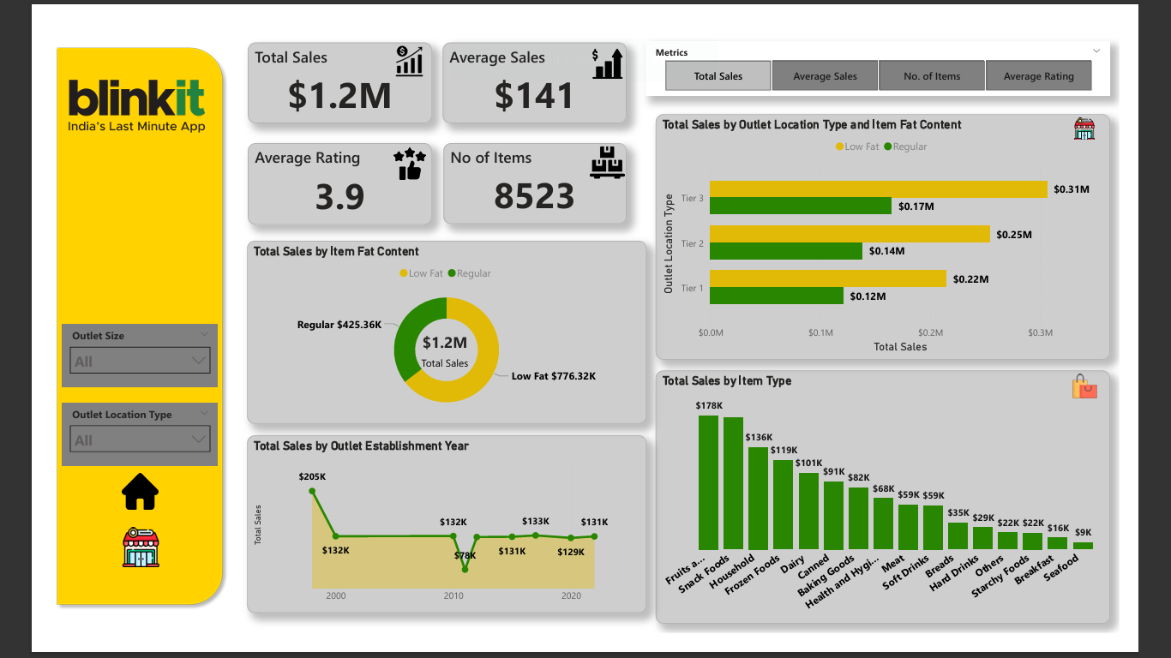
📊 Power BI Dashboard

Slide 6
🚀 Business Impact & Recommendations
✅ Data-Driven Outcomes :
📈 15% stocking efficiency improvement → Demand-based inventory forecasting.
💰 Increased high-margin product focus → Prioritizing top-rated items.
🤝 Enhanced customer engagement → Promotions on high-rated, high-demand products.
📌 Actionable Recommendations :
✔ Optimize low-performing categories – Rethink pricing & marketing.
✔ Target high-value customers – Personalized discounts for frequent buyers.
✔ Reduce delivery times – Identify delays using real-time data.

